Slide 1

IP Pathways
Security Toolkit & DR Strategy with AdaptiveCloud™

Slide 2

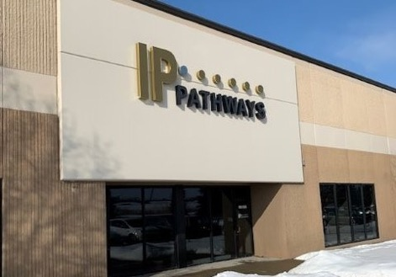
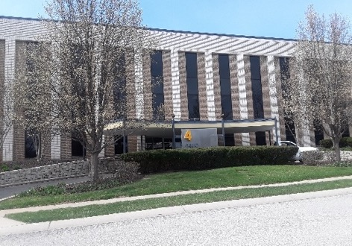
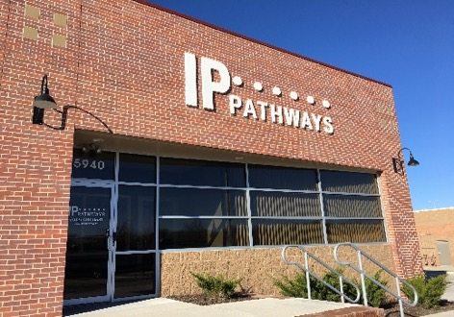
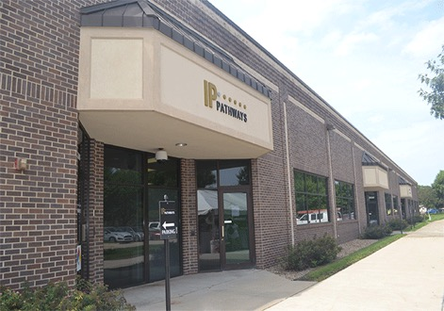
Providing trusted IT SOLUTIONS
FOR OVER A DECADE

Slide 3



Security Toolkit
BYOD
Managed SIEM/SOC
DNS Security
Multi-Factor
Authentication
Data Protection
- Backup – Air gap/Immutable
- Disaster Recovery
- A/V Endpoint
- Patch Management
Firewall/FWaaS
Branch Office
Corporate Office
Remote Worker

Slide 4
Security Toolkit
Corporate Office | Branch Office | Remote Worker | Bring Your Own Device (BYOD)
Firewall/FWaaS | X
Data Protection - Backup (Air gap/Immutable) - DR - A/V Endpoint - Patch Management | X X X X | X X X X | X X
DNS Security | X | X | X
Multi-Factor Authentication | X | X | X
Managed SIEM/SOC | X | X
Penetration Testing | X
Security Policy/Framework | X | X | X
Cyber Insurance | X | X | X
Mobile Device Management (MDM) | X | X | X
Notes:
Add Air Gap / Immutable to Backup

Slide 5

Firewall/FWaaS
Perimeter security is the first line of defense.
Talent shortage is problematic.
Firewall’s aren’t “set it and forget it”. Must have a maintenance and review strategy.
Firewall as a Service can assist with resource issues and capital constraints for the latest technology.
Managed SIEM/SOC
DNS Security
Multi-Factor
Authentication
Data Protection
- Backup – Air gap/Immutable
- Disaster Recovery
- A/V Endpoint
- Patch Management
Firewall/FWaaS
Notes:
BULLETS NEED UPDATED

Slide 6

Data Protection
Many facets to data protection.
Endpoint protection, patch management, backup and data replication are all critical components.
An “air gap” or immutable backup or replication strategy must be deployed to ensure data integrity.
Solutions, including disaster recovery, must be tested on at least an annual basis.
Managed SIEM/SOC
DNS Security
Multi-Factor
Authentication
Data Protection
- Backup – Air gap/Immutable
- Disaster Recovery
- A/V Endpoint
- Patch Management
Firewall/FWaaS
Notes:
BULLETS NEED UPDATED

Slide 7
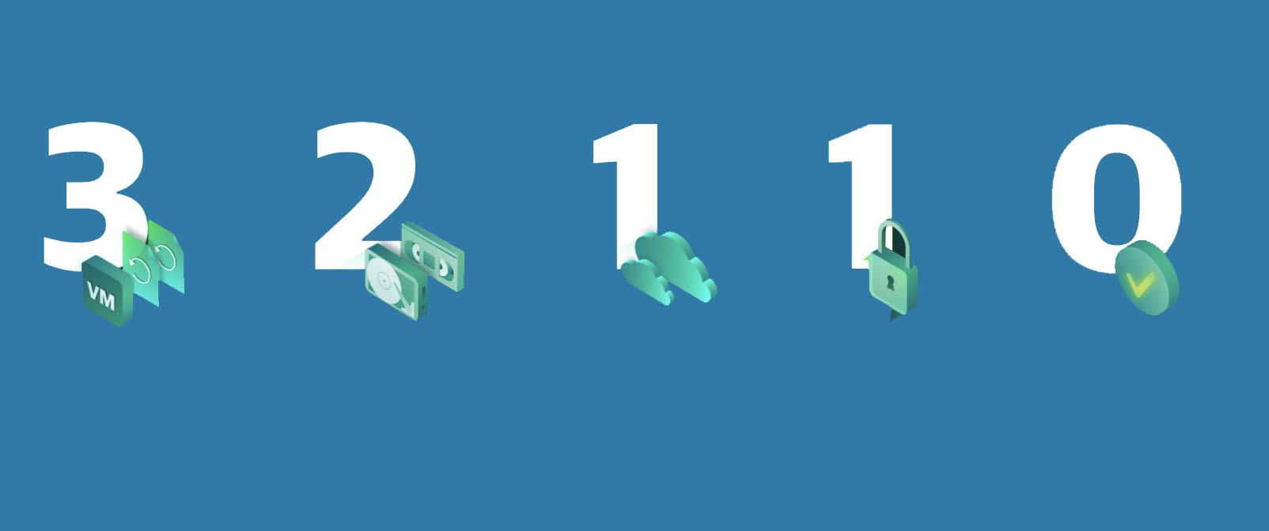
Data Protection: 3-2-1 Rule
3 Different Copies of Data
2 Different Copy Types
1 Offsite
Copy
Of which is:
Offline air gapped
or immutable
No errors after automated backup testing & recoverability verification
Notes:
Air gap – Immutable Backup

Slide 8


Iowa College Case Study
Takeaways
No multi-factor authentication.
Ransomware caused a nearly two-week systems outage impacting over 1,000 students & faculty.
College didn’t have a disaster recovery plan that was contracted and previously tested.
Law enforcement stepped in and halted recovering from backups until investigation concluded.
2x
Notes:
DMACC Case Study

Slide 9

Multi-Factor Authentication
MFA is now REQUIRED for cyber insurance.
WFA stops close to 99% of all external attacks.
Easy to deploy, cost effective and easy to manage.
Can be provided as a managed service to reduce overhead and capital expense.
Managed SIEM/SOC
DNS Security
Multi-Factor
Authentication
Data Protection
- Backup – Air gap/Immutable
- Disaster Recovery
- A/V Endpoint
- Patch Management
Firewall/FWaaS
Notes:
BULLETS NEED UPDATED

Slide 10
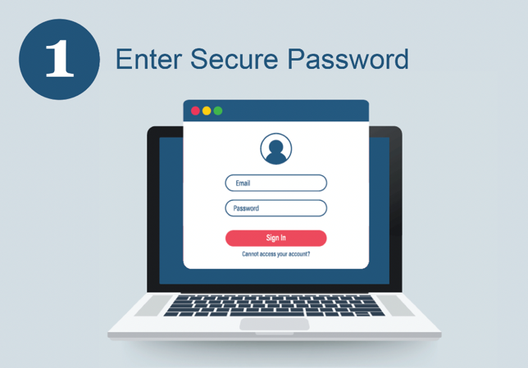
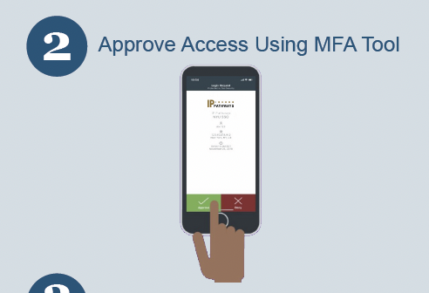
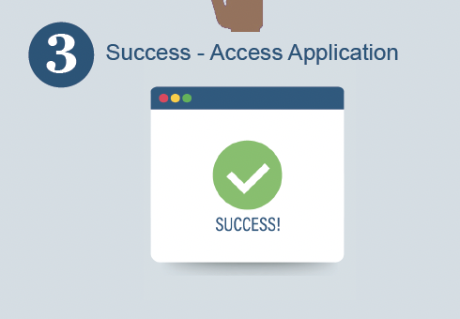
Multi-Factor Authentication
Notes:
MFA Process

Slide 11

DNS Security
An additional layer of protection between an employee and the internet by blacklisting dangerous sites and filtering out unwanted content.
Can avoid unnecessary risks and the potential for malicious attack
This is a quick change but does include end user education. A trusted partner can help you navigate both.
Can be provided as a managed service.
Managed SIEM/SOC
DNS Security
Multi-Factor
Authentication
Data Protection
- Backup – Air gap/Immutable
- Disaster Recovery
- A/V Endpoint
- Patch Management
Firewall/FWaaS
Notes:
BULLETS NEED UPDATED

Slide 12

Managed SIEM/SOC
Continuous monitoring of your environment with real world analytics.
SOC capability to alert in the event of a breach.
Data without analytics is useless.
Must have the ability to respond and remediate, not just document.
Managed SIEM/SOC
DNS Security
Multi-Factor
Authentication
Data Protection
- Backup – Air gap/Immutable
- Disaster Recovery
- A/V Endpoint
- Patch Management
Firewall/FWaaS
Notes:
BULLETS NEED UPDATED

Slide 13
Other Considerations
Corporate Office | Branch Office | Remote Worker | Bring Your Own Device (BYOD)
Firewall/FWaaS | X
Data Protection - Backup (Air gap/Immutable) - DR - A/V Endpoint - Patch Management | X X X X | X X X X | X X
DNS Security | X | X | X
Multi-Factor Authentication | X | X | X
Managed SIEM/SOC | X | X
Penetration Testing | X
Security Policy/Framework | X | X | X
Cyber Insurance | X | X | X
Mobile Device Management (MDM) | X | X | X
Notes:
Security Policy Framework – have you invested the time and the effort to truly develop a blueprint and plan to help your organization navigate security?
End User Education – Do you have a formal and frequent training process in place? Scammers are hitting both email and text of employees. Ensuring your end users are confident in how to avoid these risky scams is so important!
Cyber security insurance – Did you know that 60 percent of companies go out of business within six months of experiencing a cyberattack? We certainly can’t help you with cyber-insurance but we recommend you are investing here.
Annual Security testing – How confident are you in the stack you have architected? Are you testing and measuring its success?

Slide 14
Keep Your Organization Out of the Headlines
Notes:
TITLE SLIDE – OPTION 3

Slide 15
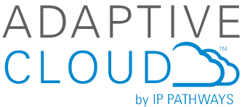
Notes:
Last, but not least: Focus on IP Pathways branded and created products and services
Decrease reliance on vendors
Our products tailored to our customers
Flexible offerings powered by our data centers and teams
Build upon our AdaptiveCloud platform
More features
More branding options
More geos

Slide 16

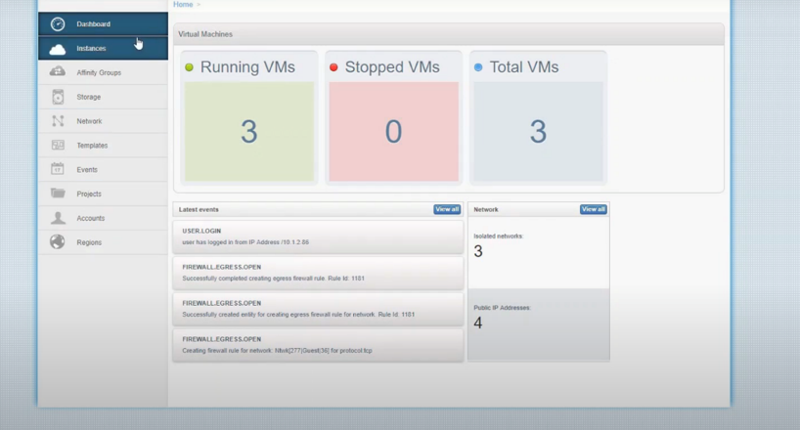
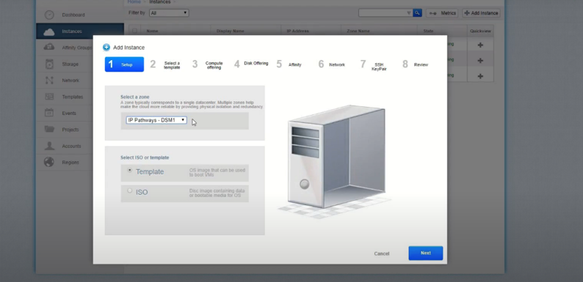
AdaptiveCloud™ - Cloud Service
AdaptiveCloud™
With the right cloud platform, you can scale and innovate faster while protecting and securing your data. Our flexible, tailored solutions are designed and supported by our team of cloud experts, allowing you to realize long-term savings.

Slide 17













Hybrid IT Solutions
Adaptive Cloud –
Virtual Private Network
Storage–as-a-
Service
Compute-as-a-
Service
Disaster Recovery
Compute-as-a-Service
Storage Replication-as-a-Service for NetApp
Storage Vault-as-a-Service for NetApp
Cloud Backup Using Veeam Cloud Connect
Desktop-as-a-
Service
Intelligent Monitoring Services
Office 365 with
IP Pathways
Notes:
WORKING ON THIS
Our purpose-built community cloud connects you with quickly deployable, highly scalable, robust and secure hosted Enterprise managed Cloud Services—all with endless uptime. Our AdaptiveCloud™ services leverage hybrid cloud to meet your specific needs. Your new-found agility accelerates time to market and frees up staff to focus on growing your business. We make sure your resources are optimized, your infrastructure keeps pace with innovation and you’re always positioned to respond quickly to competitive pressures.
Services:
Adaptive Cloud - AdaptiveCloud™ Virtual Private Cloud (VPC) provides you with Enterprise Cloud resources on demand, when you need them. Our service is consumption-based so you’ll get a predictable level of compute and storage power and pay a predictable price.
Storage-as-a-service - Storage-as-a-Service (STaaS) provides you with an economical option for deploying Enterprise Cloud Storage to support high-performance, business-critical applications while gaining efficiencies, including deduplication and compression. Get a predictable level of service and guaranteed performance (IOPs) options with easy-to-budget all-inclusive pricing.
Compute-as-a-service - Compute as a Service (CaaS) provides you with Enterprise Cloud dedicated compute power for high-performance, business-critical applications. Our service offers bare-metal speeds, predictability, and scalability at an extremely affordable price.
Disaster Recovery Compute-as-a-service - Disaster Recovery Compute-as-a-Service (DRCaaS) provides Enterprise Cloud Compute power for disaster recovery and business continuity. Grow with confidence knowing you’re prepared for anything.
Storage Replication-as-a-service for NetApp - provides NetApp FAS 7-Mode and cDOT—economically advantageous options for replicating mission-critical data offsite. Replication from your NetApp FAS 7-Mode or cDOT storage system is configured to our cloud-based NetApp FAS storage system using SnapMirror® or SnapVault® NetApp software. This gives you a consistent level of service for a price that’s easy to budget. Connectivity can be via the Internet or a private circuit.
Storage Vault-as-a-service for NeApp - provides NetApp FAS 7-Mode and cDOT users with an easy, affordable way to replicate data offsite for long-term retention. Replication from your NetApp FAS 7-Mode or cDOT storage system is configured to our cloud-based NetApp FAS storage system using SnapVault® NetApp software. Gain a consistent level of service for a predictable cost. Connect via the Internet or a private circuit.
Cloud Backup Using Veeam Cloud Connect – Whether you need a main repository for your backups, additional bursts of capacity if your local repository is full, or an offsite copy for compliance or longer-term retention—we’ve got your covered, delivering a consistent level of service at a predictable price. We keep things secure with data encryption in flight, plus offer advanced features, such as WAN acceleration and deduplication.
Desktop-as-a-service – provides hosted virtual VMware Horizon View® desktops and applications in the cloud so your users can access their personalized desktop from any device, anywhere, at any time—taking productivity to a whole new level. Desktops are provided as a cloud service so you get a fully-managed infrastructure, complete with industry compliant security, without the cost and complexity of deploying and managing virtual desktops onsite.
Intelligent Monitoring Services - proactively monitors the health of your systems, allowing you to address minor issues before they escalate into big problems that disrupt your business. Gain peace of mind knowing your critical systems are continuously monitored 24x7x365, without any capital costs or dedicated staff.
Office 365 - Office 365 support lets you take advantage of Office 365’s robust security, 24×7 accessibility and increased user productivity—without the hassle of buying and managing it. We do it for you using a consumption-based model that’s simple and cost-effective. You only pay per user, per month and receive comprehensive, turnkey service.

Slide 18


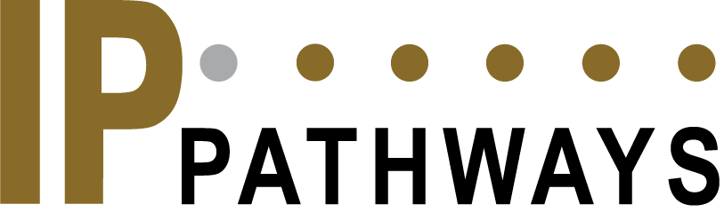


Hybrid Integration & Managed Network Services
Carrier Services
Custom Strategies
AdaptiveCloud™
Managed or
Unmanaged Solutions
Notes:
Option 2

Slide 19






IT Solutions
Managed Services :
Remove the burden of running your technology in-house. Access our network of experts ready to solve your current challenges through custom IT services.
Cloud :
A complete suite of flexible, tailored cloud solutions to meet you where you’re at today and design your future.
Security :
Protect your data from outside threats while ensuring the right people can access the right information.
Backup & DR
Set a strong strategy to ensure your data is always accessible, reduce risk of downtime, and recover quickly when the unexpected happens
Monitoring :
Do business without interruptions, while our team proactively monitors the health of your systems and keeps them running as they should.
Data Center Colocation :
Staffed 24x7x365, with carrier-grade connectivity, you get the data center support you need within your budget.

Slide 20
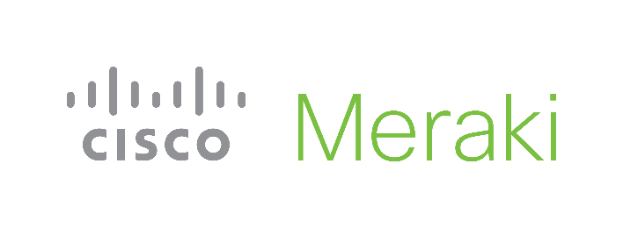
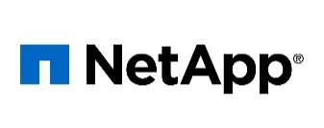
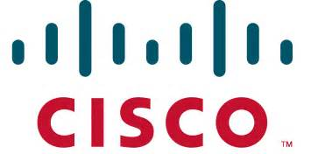
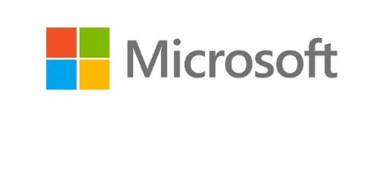
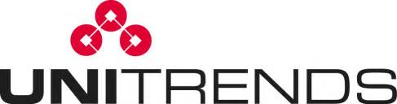
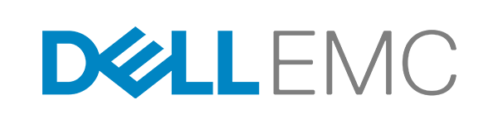
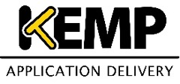

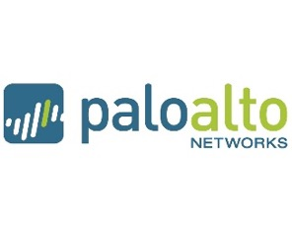
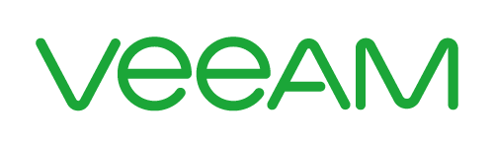


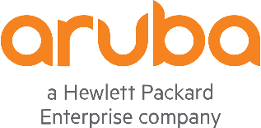





Vendor Network

