Slide 1
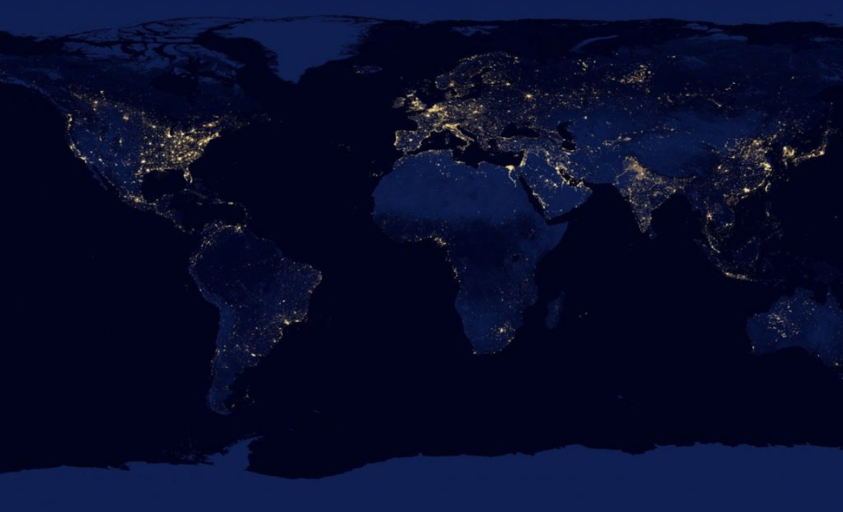
Company Introduction
Oct 2021
Note: This information is Security On-Demand Confidential & Proprietary - Distribution is Prohibited

Slide 2
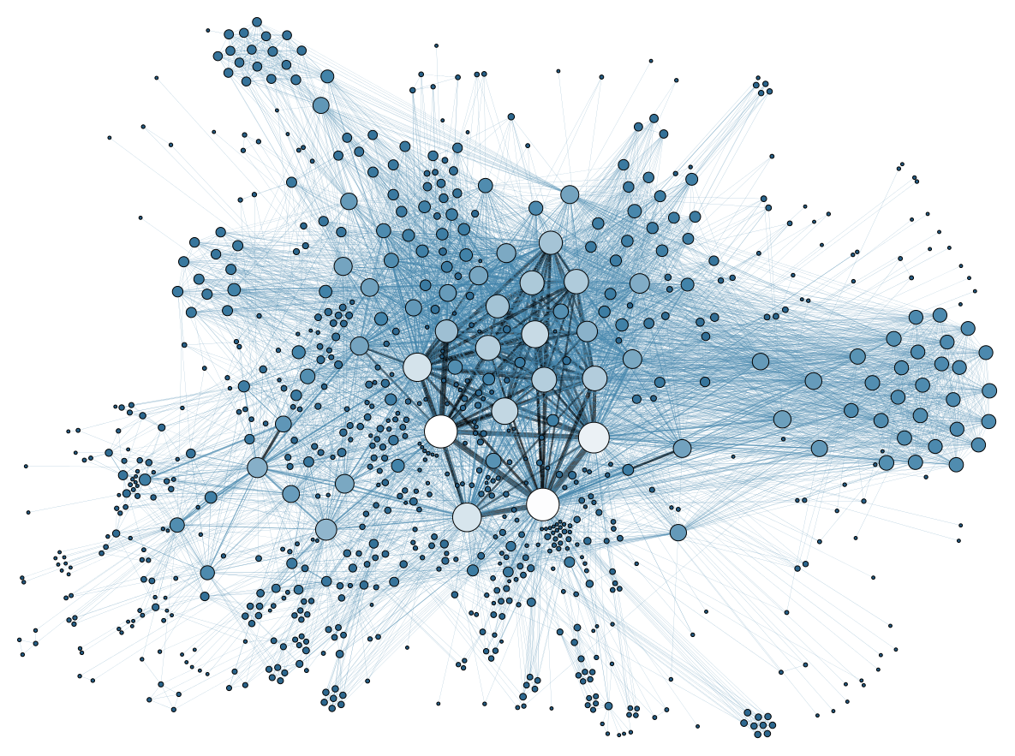
Current State
The Challenge:
Detection windows are shrinking
Most are new attacks & vectors not previously identified
Ransomware
# 1 Cyber-threat today
Ransomware Attacks are still penetrating defenses
Attacks have become primarily Dynamic, rather than Static
*Our Focus: Find threats in the data that cannot be detected with Static Detection Approaches (SIEM, XDR, MDR, EDR, XDR, etc.)
Notes:
SOD estimates its catch rate is 70%. We can detect attackers hiding in plain sight.
Our Focus is to find threats in the data that are missed or not detected by service providers in today’s marketplace

Slide 3
Static vs Dynamic Threat Detection/Remediation
Dynamic Threat Detection
Dynamic
40% of Threats Today Are Static
The are Known Threats
Recognizable/Known
Do not regularly change, evolve, or transform
60% of Threats Today Are Dynamic
They are Unknown Threats
Very hard to Detect
Change Constantly
Cannot be identified using signatures, IOC’s, Rules
Simulate “normal” behavior
“D2”
Dynamic + Dynamic
Static
Remediation
Static
Dynamic
Remediation
Dynamic
“S2”
Static + Static
Static Threat Detection
Static
Notes:
Domains generated by dictionary DGA tend to be more difficult to detect due to their similarity to legitimate domains.

Slide 4
Managed Security Generational Model
Gen 9
Adaptive
Gen 8
Offensive
Fully Adaptive AI, Black on Black (Low Latency networks)
Gen 7
Machines
Structurally counter-offensive, (unit 8200 subscriptions)
Security On-Demand
Gen 6
Dynamic
Machines Auto-Defending against Attackers, Semi-autonomous Defenses Auto Remediation (stealth, kill and replace)
Gen 5
Analytics
Dynamic Threat Detection – Full spectrum detection using Pre-Threat, Unsupervised Machine Learning, Proactive Threat Hunting, Dynamic Remediation
Gen 4
Static
Industry
Threat Analytics, Behavior-based analysis, Analysis of ALL the data, Asset Behavior Modeling, Supervised Machine Learning for both Threat Detection & Scoring, Basic Orchestration
Gen 3
Correlation
MDR/XDR (Managed Detection & Response) and SOAR performing static threat analysis to compress costs and increase efficiency in the SOC, decreasing labor costs, Response tends to be non-automated
Gen 2
Compliance
SIEM-based correlation for static threat detection across multiple log sources & devices, labor intensive to find the threats – relying on human expertise & experience to write rules and monitor alerts
Gen 1
Aggregation
Compliance & GRC, primary focus on being compliancy and reporting rather than secure
Log Aggregation solutions with large staffs of people to sift through logs

Slide 5
The Race to Zero
1) False Positive Alerts
SOC Worker Cost/week
3rd
U$ 801,199
Generation 3 (Low)
Generation 6 (Advanced)
4th
U$ 30,346
5th
U$ 2,135
3rd
4th
5th
6th
U$ 85
5th
4th
3rd
4) Time to Find
2) % of Threats NOT
Found
0
Quarters
Months
Days
Hours
19%
30%
58%
77%
6th
5th
4th
Asset Dollar impact dependent on brand value
3rd
3) Missed Alerts
aka – “False Negatives” - Damage from attacks that get through, but are missed – Per/ week
Note: False negative costs are widely divergent based upon industry, organization size and brand value.

Slide 6
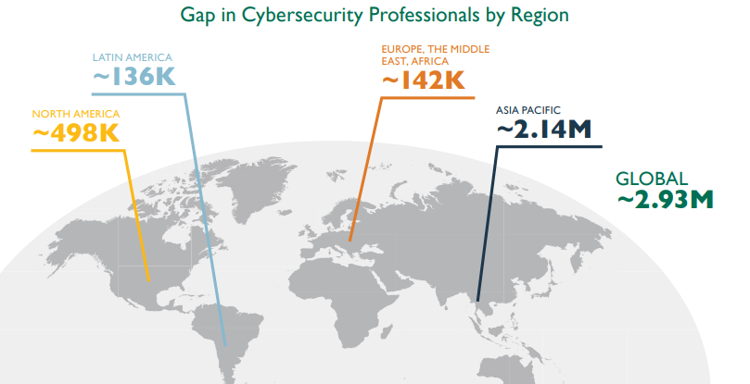
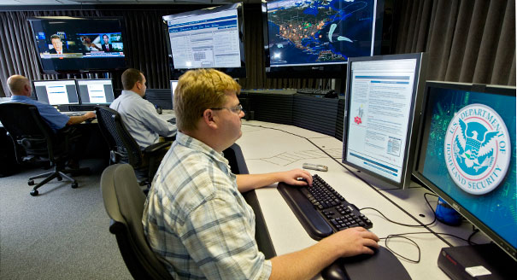
The Cyber Security Talent Shortage and the
High Cost of Building a SOC
Trying to build your own SOC with all the security tools and staff can well cost over $1M and ongoing cost upward of $500k per year, if not more
As of 2018 there were close to 500K in Cyber job openings that were not being filled
Source: https://www.peoplemattersglobal.com/news/talent-conversation/asia-pacifics-cybersecurity-workforce-gap-hits-214m-19654

Slide 7
SIEM/MDR vs. Analytics
A SIEM (Security Information and Event Management) provides security alerts generated by applications and network hardware.
Threat Analytics Can Enhance the SIEM or can Replace
SIEM/MDR
Detection Reliant on Rules-based technology (Pre-knowledge)
Static Threat Detection
Licensing based on Log/Data Volume - Unpredictable pricing model - charges based on Events Per Day (EPD)
Requires “people, process and technology” with a high cost to maintain
Cannot Detect Unknown Threats
Too Many False Positives Alerts on hundreds or thousands of investigations every week
Analytics (ThreatWatch)
Patented technology, including artificial intelligence, machine learning, behavioral analysis and a fully-staffed SOC team to handle all investigations
Dynamic + Static Threat Detection
No Limits to Data Volume in Pricing Model
24x7x365 monitoring by state-of-the-art SOC – Bots are L1 SOC
Predictable per device pricing model, regardless of the number of events
Our SOC analysts investigate those alerts, write up our recommendations and only involve the customer when there is a real threat

Slide 8
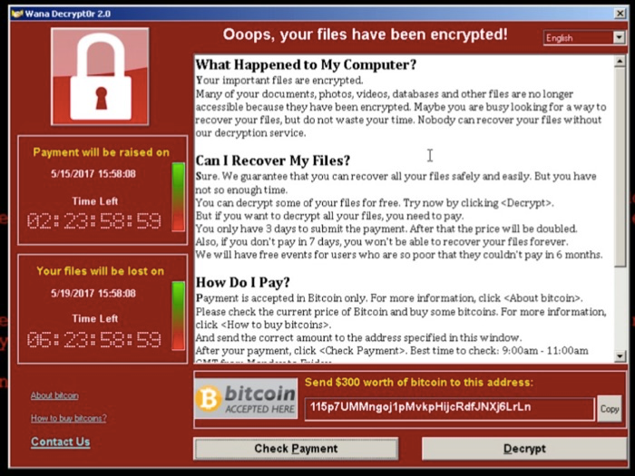
Your Worst Day…
No news is good news, right?
In the cyber-security world, you can’t assume that since everything is calm, everything is good
So many companies today are compromised, but don’t know it
So what happens when you embark upon your “worst day?
Notes:
Ransomware

Slide 9
Story 1 – CEO Story
What a Fellow CEO Told Me
“Several weeks of being down would has imploded our businesses. Not worth the risk!
All of our systems and backups were encrypted by the threat actor.
I aged a year in one week, I never want to live Ransomware again!”
We Thought We Were Prepared
The Impact
We had no choice but to pay the ransom.
Notes:
What a Fellow CEO Told Me
“Several weeks of being down would has imploded our businesses. Not worth the risk!
All of our systems and backups were encrypted by the threat actor.
I aged a year in one week, I never want to live Ransomware again!”
We Thought We Were Prepared
We thought we had reasonably good systems with 30+ days of onsite back-up in two locations in two countries.
Plus a clustered network redundant in two countries with multiple copies of all operating systems and data.
We had dual authentication on all admin user passwords, which somehow the threat actors were able to disable.
The Impact
All systems were encrypted so that we had no use of our software or servers.
We had to process payroll for 10,000 people largely manually working around the clock to do so.
We had to do workarounds manually for over a week with an army of people.
We had no choice but to pay the ransom.

Slide 10
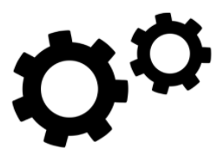
The Costs of Ransomware to Business
66%
of organizations lost revenue following a ransomware attack.
32%
of organizations lost C-Level talent as a direct result of ransomware attacks.
35%
of businesses that paid a ransom demand shelled out between $350,000-$1.4 million, while 7 percent paid ransoms exceeding $1.4 million.
29%
laid off employees due to financial pressures following a ransomware attack.
26%
of organizations were forced to close down operations entirely following a ransomware attack.
53%
of organizations’ brand and reputation were damaged in a successful attack.
(Cybereason Report, Ransomware, the True Cost to Business)
Notes:
66% of organizations lost revenue following a ransomware attack.
35% of businesses that paid a ransom demand shelled out between $350,000-$1.4 million, while 7 percent paid ransoms exceeding $1.4 million.
53% of organizations’ brand and reputation were damaged in a successful attack.
32% of organizations lost C-Level talent as a direct result of ransomware attacks.
29% laid off employees due to financial pressures following a ransomware attack.
26% of organizations were forced to close down operations entirely following a ransomware attack.

Slide 11
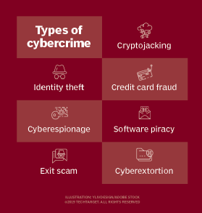
The Problem – Why Now?
Cyber-Criminal Focus is Shifting
Previously
Credit Card & Identity Theft
Complacency Developed
Ransom in exchange for computer access is not new
AIDS Trojan – Developed in 1989, Joseph Popp
Encrypting ransomware returned to prominence in late 2013 with the propagation of CryptoLocker
Bitcoin Used for first time
Procured $27M from infected users
Became widely copied
What is unique about now?
Notes:
In the old days…
Cyber Criminals were focused on Credit Card & Identity Theft – to recover from an incident, you could write a letter saying you’re sorry that their info was stolen
Many of us became complacent about this type of theft – it mostly because it was perceived as primarily affecting big companies and not little ones
Also because it didn’t affect a company’s ability to operate
The first known malware extortion attack, the "AIDS Trojan" written by Joseph Popp in 1989, had a design failure so severe it was not necessary to pay the extortionist at all. Its payload hid the files on the hard drive and encrypted only their names, and displayed a message claiming that the user's license to use a certain piece of software had expired. The user was asked to pay US$189 to "PC Cyborg Corporation" in order to obtain a repair tool even though the decryption key could be extracted from the code of the Trojan. The Trojan was also known as "PC Cyborg". Popp was declared mentally unfit to stand trial for his actions, but he promised to donate the profits from the malware to fund AIDS research.^{[28]}
Encrypting ransomware returned to prominence in late 2013 with the propagation of CryptoLocker—
Shift to Remote
Since the onset of COVID-19, much of the workforce has shifted from offices to homes. This was done out of necessity and without much notice. Most employers have not considered the security implications of working remotely, nor have they assessed the related security risks.

Slide 12
Multiple Forces Coming Together
Ransomware Proliferation
Bitcoin Adoption
Ransomware-as-a-Service Model
Rapid Shift to Remote Work (Covid)
Social Engineering Sophistication
The combination of these forces has fueled the rapid scaling of a new cyber-criminal eco-system
Notes:
Bitcoin has been a significant factor in the rise in ransomware attacks. The lack of oversight by any governing body coupled with anonymity makes it an ideal currency in ransomware demands.
The evolution of ransomware-as-a-service (RaaS) has also played a significant role in the proliferation of attacks. RaaS has moved the execution of a ransomware attack from "professional" to "script-kiddie."
Operating systems lack runtime detection capabilities that could help stop ransomware execution in the early stages possibly even before actual encryption begins."
Another reason that ransomware continues to proliferate, despite classic delivery methods such as email, is that users have not been properly trained or made aware of the dangers of opening malicious email attachments. This trend highlights a need among organizations to improve web and email security and user security awareness.

Slide 13
The Criminal Eco-System is Expanding
The attackers feel justified in what they are doing
Wealth Disparity – (Robin hood syndrome)
“Ransomware is the Guillotine”
MountLocker's operator says: "We use network security holes the same way lawyers use legal holes."
Ransomware is Scalable
If criminals, operating remotely, can make massive profits while incurring little risk to themselves, why would they ever stop?
State Sponsored Attacks
It’s not all for profit
Some governments are getting criminal gangs to do their hacking for them
Notes:
Geographic Focus
Off Limits – Russia/Ukraine/Georgia
Poor Countries also Not a Target (India, Pakistan, )
Hospitals Considered Easy Money

Slide 14
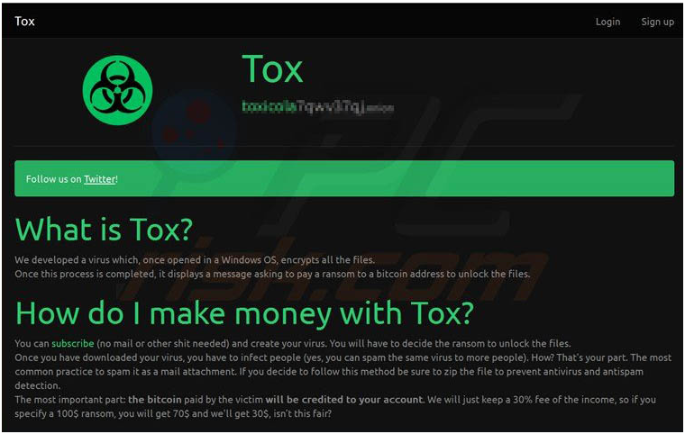
Ransomware as a Service (RaaS)
Makes it easy for anyone to launch an attack
Fairly large criminal eco-system
The attacker gets to set the ransom amount $$
Disgruntled employee
Provides attack vector against the company
Receives the money from attack

Slide 15
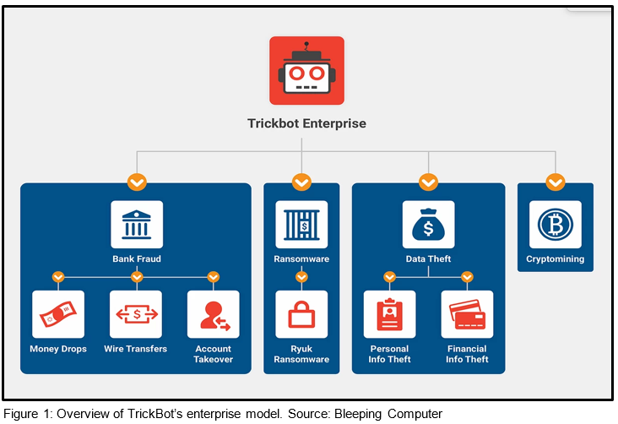
How Does Ransomware Get Into the network?
The top 4 exploited paths or vectors are:
RDP/Remote Access (Stolen Credentials/Elevated Privileges)
Phishing/Social Engineering
Software Vulnerabilities/Lack of Patches
Lateral Movement - SMB
Any/All of these can be used in combination
Note: Are Coupled with other forms of malware that establish the beachhead
For example Trickbot
Notes:
Trickbot masquarades as
Invoices, holiday greeting cards, official government notices, Covid-19 pandemic information, infected documents (malspam – macro laden office documents)
Note: Are Coupled with other forms of malware that establish the beachhead
Trickbot
Finds a path in and establishes itself
Then acts as a dropper for the Ransomware (typically Maze or Ryuk)
Trickbot is multi-faceted and can used to commit
Bank Fraud
Disseminate Ryuk Ransomware
Perform Data Theft
Perform Crypto-mining

Slide 16
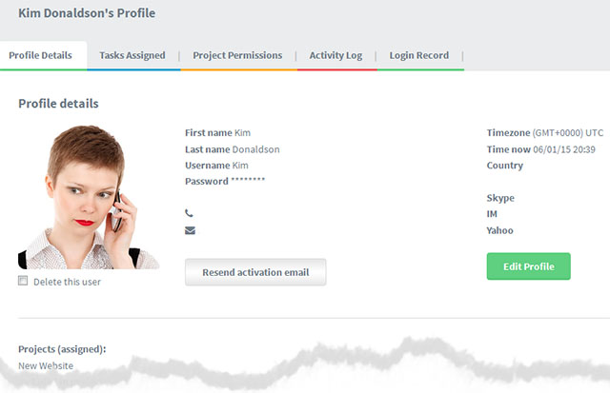
Why is Detecting Ransomware so Difficult?
It conducts itself like a “normal user”
Reads, writes, opens files, creates files, lookups, downloads, etc.
Speed of the Attack
Hackers used to sit in your system for months, sometimes year – No Longer
Attackers have already breached the network/endpoints/user access/etc.
It’s the “end” phase of an attack - Once the encryption happens, you’re too late
Static Detection Methods are ineffective
Signatures, IOCs, Rules
New variations coming out constantly

Slide 17
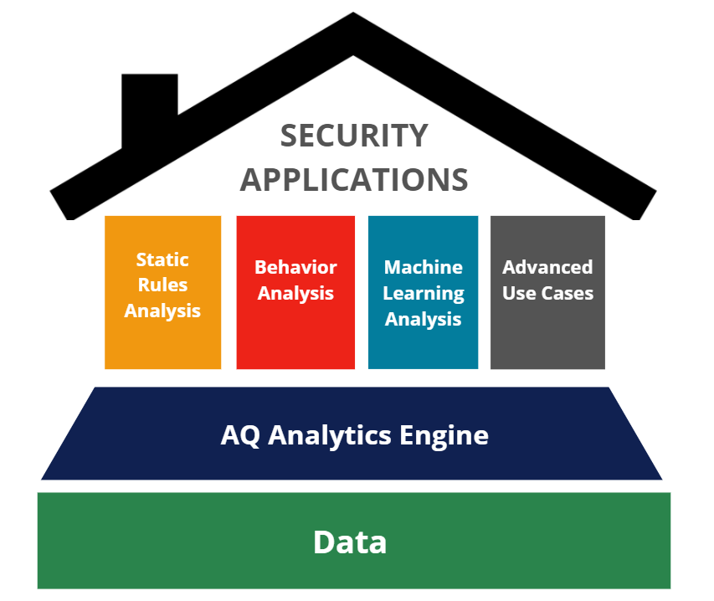
The Data Problem
Data access (speed & accuracy) is the inhibiting factor in threat analysis today
SOD’s differentiation is based on our AQ Analytics Engine
The AQ engine continuously analyzes all the data and then optimizes it for Machine Learning based analysis
By leverage multiple detection models, we can perform superior threat analysis
SOD’s core focus has been to find that threats that no one else can find in the data
Notes:
Security is in essence a Data Problem
SOD’s core focus has been to find that threats that no one else can find in the data
No matter what model or method applied, there are always questions to ask –
Machines don’t question assumptions, only humans do
Humans always will have other questions to validate an assumption

Slide 18
Cyber Security is a Big Data Problem
1 Volume Velocity Variety
2 Resource Costs
3 Analyzing All the Data
4 Detection of Unknown
5 Machine Learning
Each of these issues have their own Big Data challenges
Compute, Storage, Speed & Size are all underlying factors in addressing these issues
SOD’s AQ Technology is an underlying analytics technology that solves each of these problems
Notes:
It’s not about security analytics, it’s Big Data
1st – Volume, Velocity, Variety (3 V’s)
Storing the original data set is expensive
2nd - Resource Requirements
Once stored, accessing the data set quickly is another problem
3rd – Analyzing All the Data
Reducing the data set, eliminates indicators
4th - Detection of Unknown Threats
What happens when something previously unseen occurs?
5th – Optimizing Machine Learning
How can ML be used to find hidden threats with large data sets?

Slide 19
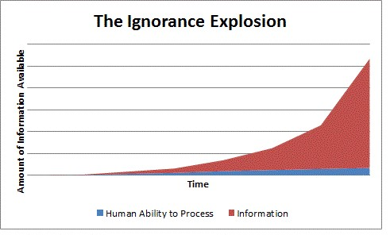
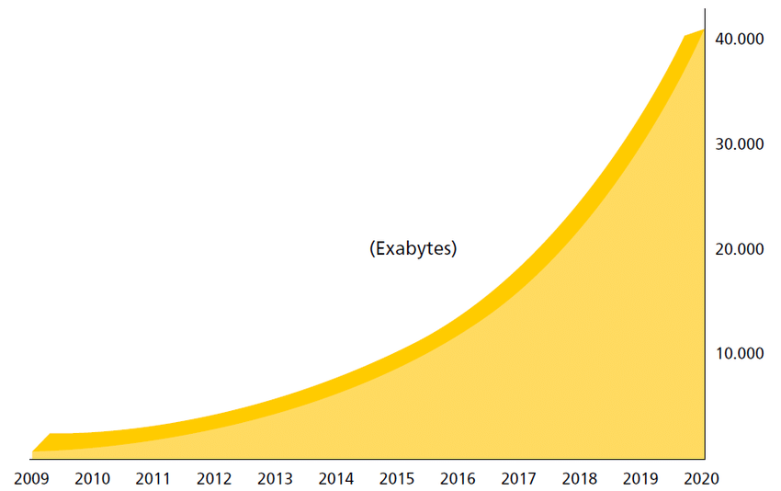
The Evolutionary Data Curve
The issues surrounding Advanced Cyber Security is not about the analysis it is about the data.
Data management is the cyber security industry’s biggest challenge
In the new realities of today the bad guys are taking an unfair advantage of organizations going through wrenching change.
These unanticipated changes expose organization to a whole new set of threats.
At the heart of this problem that most security solutions do not look at all the data.

Slide 20
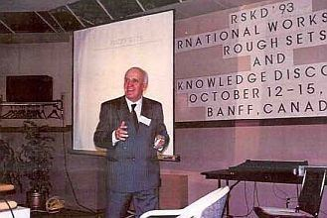
AQ Technology Foundation
Rough Set Theory was developed by Zdzislaw Pawlak (1926-2006) in the early 1980’s
Rough Set Mathematics constitutes a sound basis for Knowledge Discovery & Datamining (KDD); it offers mathematical tools to discover patterns hidden in data
It can be used for feature selection, feature extraction, data reduction, decision rule generation, pattern extraction, etc.
Our AQ Technology utilizes this foundation to analyze and find otherwise indiscernible data about threats
Professor Zdzislaw Pawlak, founder of the Polish school of Artificial Intelligence and one of the pioneers in Computer Engineering and Computer Science with worldwide influence.
Notes:
Rough Set Mathematics constitutes a sound basis for Knowledge Discovery & Datamining (KDD); it offers mathematical tools to discover patterns hidden in data
It can be used for feature selection, feature extraction, data reduction, decision rule generation, pattern extraction, etc.
Rough Set Methodology is based on the premise that by lowering the degree of precision in the data, it makes the data pattern more visible.
In other words, it can analyze and find otherwise indiscernible differences among attributes in a dataset.

Slide 21
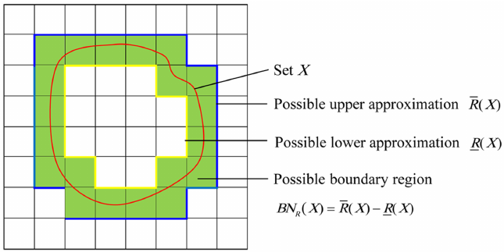
Real World Problems Solved by Rough Set (AQ)
Real-World Issues it Can Solve
Very large Data Set Analysis (Data Lakes, etc.)
Data Mining in distributed or multi-agent systems
Mixed Data Types – Continuous Values, Symbolic Data
Uncertainty (Noisy Data) – Any data set where signal and noise are both high
Incompleteness (Missing or incomplete data)
Use of Background Knowledge
Notes:
Joel
Focus on “Noisy Data”
Today the real data is Noisy and everyone uses data filtering. Wrong. You need all the data all the time, AQ allows us to see data everyone else eliminates.”

Slide 22
What Does AQ Technology Do?
Speed/Query Performance
AQ Technology accelerates data access at low computational loads to 100X the speed of traditional database access.
AQ optimizes Machine Learning because it is typically bottlenecked by Data Access.
Storage Size
Uses a mathematical model to represent the data that is about 1-3% of the original data set
Anomaly Detection (Analytics)
It identifies and “maps” anomalies in the data without any foreknowledge of what to look for.
Notes:
Anomaly Detection – sub story

Slide 23
We built our Use Cases on AQ Analytics Capabilities
Device Telemetry
(Data Lake)
AQ Technology
Multi-Dimensional Access Layer (MDAL)
ThreatWatch Platform
Threat Analytics
Security
Ops
(SOC)
Actionable Response
Notification
Orchestration
Investigation
Incident Response
Client Portal
Asset Data
AQ Technology
“MDAL”
Packet Data
Web Logs
User Data
Log Data
Threat Intel
Flow Data

Slide 24
Attack Examples & IOC Search Response Times
Attack Name | IOC Search Included | Columnar DB Query Time | SOD AQ Query Time
Kaseya Supply Chain Attack | 1218 Domains | 9 days | 8.12 Minutes
Microsoft Exchange Hafnium Attack | 153 Indicators of Compromise (IOCs) 50 Hashes, 103 URLs | 1.06 days | 1.1 Minute
Solar Winds Orion Supply Chain Attack | 2308 Indicators of Compromise (IOCs) 10 A Domains, 6 CNames, 12 Hashes, 2280 Domains ) | 16 days | 15.4 minutes
WannaCry Ransomware Attack | Network activity searches 38 Hashes 5 IP addresses | 8 hours | 30 seconds
Notes:
Approximately 250 Customers
Last 30 Days of Data
Who Uses Columnar DBs
Amazon Redshift (SnowFlake)
Google Big Query
Splunk

Slide 25
AQ Technology Focuses on 5 Key Problem Sets
Big Data Issue | Explanation
Log Volume, Velocity, Variety | Uses a mathematical model to represent the data that is about 1-3% of the original data set Ability to inherently parse unstructured & semi-structured data String based AQ allows us to adjust “on-the-fly” for any changes in log data structure
Resource Requirements | Speed - AQ Technology accelerates data access at low computational loads to 100X the speed of traditional database access. Compute – Real-time analysis performed in-line as well as post-processing capabilities
Analyzing All the Data | No limitations on analyzing the full data set (including allowed traffic) Centralization of all customer data allows us to find commonalities across all client data
Detection of Unknown Threats | It identifies and “maps” anomalies in the data without any foreknowledge of what to seek Can know about threat indicators within an given set of data before a detailed search is conducted
Optimizing Machine Learning | Resolves the Data Access problem – utilizing the speed enhancements Reduces training time for Machine Learning models by over 60%
Notes:
Joel

Slide 26
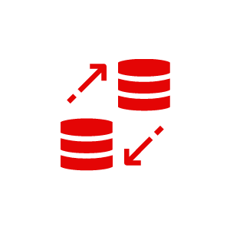
Customer Value Drivers
Customer Problem Sets
Customer Value Layers
Threat Management Layer (SOC+ Others)
Incident Response, Threat, and Consulting.
The SOD Partner ecosystem can help provide this.
Supervisory Layer (ML Prioritization)
Threat Management - Advanced Threat and case Portals, etc. SOD effectively eliminates SOC Level 1.
Dynamic Threat Finding Layer (ThreatWatch)
This requires looking at all the data (AQ.) Everyone has supervised machine learning. Dynamic Threat Finding requires Unsupervised AQ Learning and Unsupervised AQ data scanning. SOD Only
Pre-Correlation Layer (Localized Alerts)
Vendor based data for Known Threats (Microsoft, CrowdStrike, Qualys, Sophos, Symantec, Tenable)
Infrastructure Enablement Layer (Logs)
LOG Management, Data Telemetry, etc.
Data
Too Much Data - Data Ingestion Resource Requirements (Performance) .
Data Reduction blinds the threat detection engines. Data everywhere but not a threat to find…
Costs
Customers are not spending too much but wasting resources. Way to many false positives creates alert fatigue.
Unknown Threat Detection
“I do not know what I do not know” causes ELE (Extension Level Events) and Ransomware.
ML Optimization
ML Training – Without using all the data, bias in ML is introduced.
ML Execution – ML Bots need ADAT (All the Data All the Time) to find threats.

Slide 27
Analysis Layers
Client Notification & Response
6% of Investigations - Actionable
Multi-Dimensional 70% of Threats Found
ABCD Risk Scoring (QMARS) 3,000 Investigations (Machine Prioritization)
False Negative Reduction
Single Dimensional 55% of Threats Found
ThreatWatch Alerts .00005% of Events (Machine Learning)
Pattern Matching 40% of Threats Found
Localized Alerts .012% of Events (Behavioral Analysis)
False Positive Reduction
Static Rules Analysis
30% of Threats Found
Log Data Collection 100 Billion Events/Wk (Static Rules Analysis)

Slide 28
Event Distillation Process
Processed
Events
ThreatWatch
Analysis Layers
Log Data
Correlated
Events
ABCD Total
Risk Score
Attacker – Inherent Event Severity & Confidence Level
Behavior – What Behavioral indicators were identified?
Context – Relevancy to the Customer’s Environment
Defense – Defensive Actions & Countermeasures Taken
75,000,000,000
Logs
6,000,000
Events
250,000 Alerts
3,000 Investigations
250+ Notifications
ThreatWatch
Alerts
Client
Notification or
Action
ABCD Risk
Scoring
SOC Investigation
& Triage

Slide 29
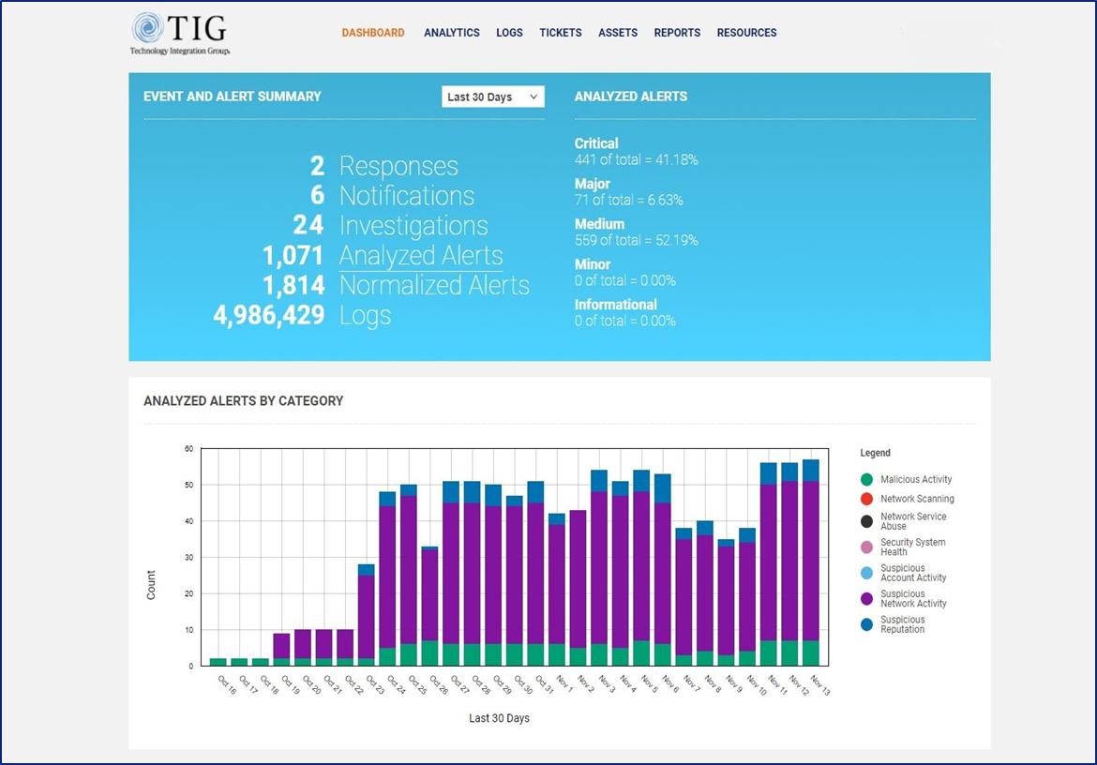
Architecture Overview
Public Cloud
SOD Cloud
Security Operations Center
Integration Hub
SORAD™ Security Event Notifications
Client
Portal
Vendor
APIs
SOC
Notification & Response
ThreatWatch
Cloud-Based
Applications
Response & Remediation
Threat
Reconnaissance Unit
Pre-Threat Indicators
Human Intel
Global Threat Feeds
Vendor Integrations
Log Analysis
Data Access Layer (AQ)
Data Warehouse
SOD Operations & Triage
Remote Users
Prioritized Alerts
Client Premises
Data Sources
Encrypted Data
Analytics Platform
Localized Alert Creation
ThreatWatch Alert Creation
Behavioral Analysis
AI Analysis
Endpoint A/V
SOC Alert Queue
(ThreatWatch Alerts)
Firewall / IPS
SOC Feedback
User Behavior
Servers
Machine Learning Detection (UAD)
Machine Learning
Detection (HAD)
Asset Behavior
Adv Use Cases
Data
Collector
(Physical/Virtual)
DNS
ABCD Total Risk Score
DHCP
Flow Logs
IOT Devices
Custom Logs
ThreatWatch Response
ThreatWatch Response
ThreatWatch RAR
Environment

Slide 30
The AI & ML Landscape
AI & Machine Learning detection capabilities for Cyber are rapidly evolving
Nearly half of organizations are expanding cognitive detection capabilities to find unknown attacks
The key issues with using ML however is
Access & formatting of the data (Data Labeling)
Adaptability of the models as the data changes
The real problem lies in training the models to find the threats
The amount of time it takes to “train” an ML model is a significant factor in detection time for threats

Slide 31
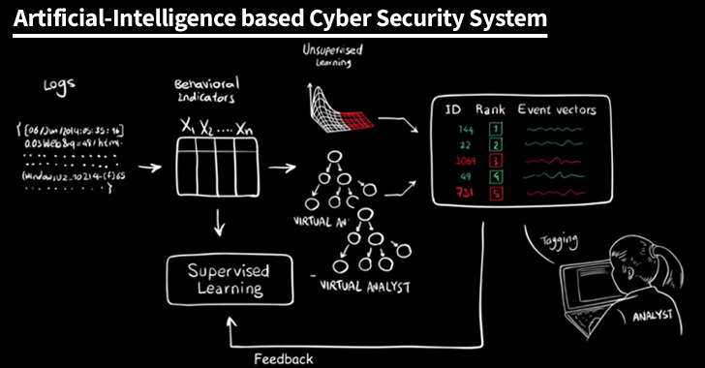
The Use of AI & ML in Cyber-Security
Almost Everyone in the Cyber-Security Industry is claiming the use of AI & Machine Learning for their product
Using AI can improve an organizations ability to respond faster to breaches
However, SOD believes that most Threat models which incorporate AI systems are still not mature.
As an industry, we are still in the in the infancy stage
Notes:
The threat landscape continues to change at a rapid speed and cybersecurity leaders must embrace AI to respond to new tactics developed by cybercriminals.

Slide 32
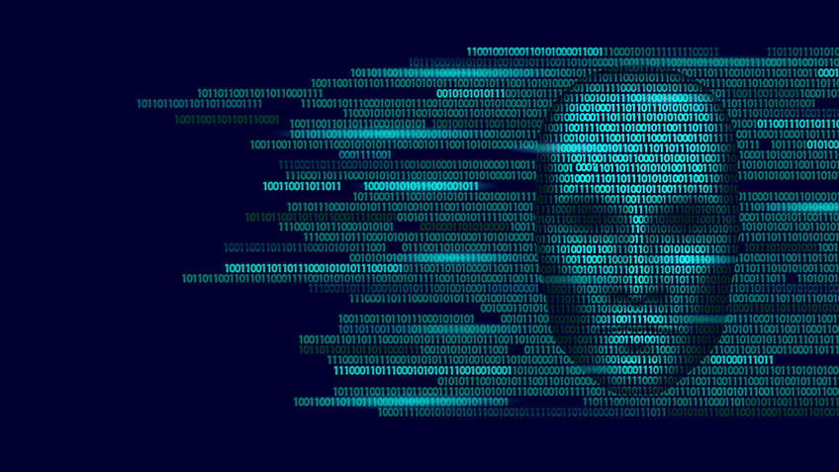
The Bad Guys are also Using Machine Learning
Just because the product vendors are using it, doesn’t the bad guys are not
The bad guys have a machine that is learning vs your machine that is learning
For example, just last year, criminals employed AI-based software to replicate a CEO’s voice to command a cash transfer of €220,000 (approximately $243,000).
Notes:
What Machines are doing the Learning?
The bad guys have a machine that is learning vs your machine that is learning
The bad guys have only one or a few targets to learn from. The defender must have a machine that can learn from hundreds if not thousands of bad guys.
Plus the bad guys can come up with all sorts of stuff not seen and machines are not yet good enough to detect slight subtleties in an attack sequence.
Finally, the Return on investment is very high for a bad guy. If you can penetrate the ransomware amounts are staggering.
The good guys are simply outmatched.

Slide 33
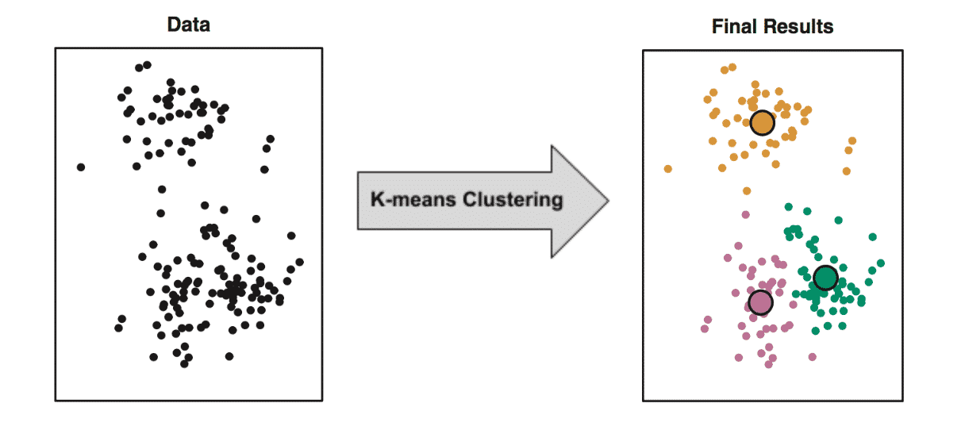
Using Unsupervised ML to Find Unknown Threats
Discerning Patterns in the Data without Knowing What to Look For
No Pre-Knowledge Required
No Baselines
No Data Bias
No Human Bias
No wrong answers
Training is minimal
UAD Analysis
Finding Patterns in Big Data where Attackers Masquerade as Normal

Slide 34
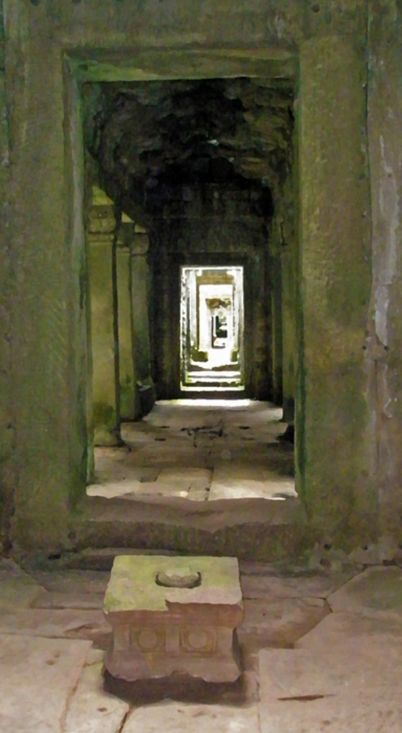
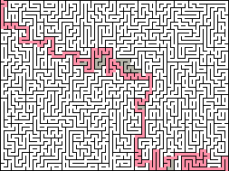
What is Unsupervised Anomaly Detection (UAD)?
SIEM analyzes data along previously defined pathways. You know how to find the threat (get though the maze) based on pre-programmed logic.
UAD analyzes all the pathways & optimizes the best path to the threat, without pre-knowledge
The Old Way (SIEM)
The New Way
(Threat Analytics)
Full Spectrum Analysis
(UAD)
UAD
Learns all the pathways
Analyzes all combinations of paths together
Notes a deviation or pattern change “on the fly”
Scores Risk
Analyze infinite destinations and paths
Analyze every path & find combinations that are unique or unusual to find the threat
Analyze a finite set of paths traveled
Notes:
UAD represents the next evolution of our threat detection capabilities and is a foundational element in our 2021 platform launch version 6.0, “Full Spectrum Threat Management”
UAD is a threat detection application uses a set of Machine Learning algorithms built on our Big Data AQ Technology base to identify subtle patterns in the data that are difficult to discern, such as when signal and noise are both high.
Unsupervised Anomaly Detection (UAD) is designed to identify pattern anomalies in the data based on historical context, without foreknowledge or pre-identification required of any threat indicators.
UAD is able to autonomously seek out threat and alert indicators from log data to supplement the alert data evaluated by the QMARS (Question Modeling/Result Scoring) system.

Slide 35
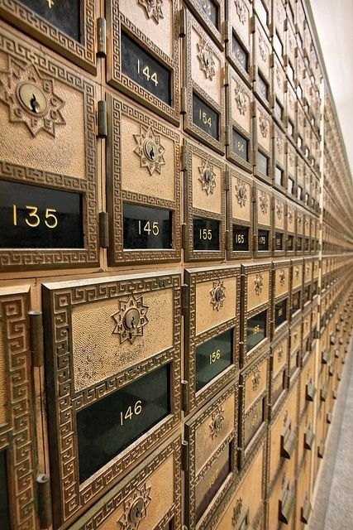
UAD - Post Office Analogy
Imagine a Post Office filled with Gazillions of mail boxes (*Actually 1.99⁴⁶ to be exact)
Imagine one of these boxes contains a threat, how do you find it?
Option 1 – Open each box one at a time (traditional 3 Layer analysis)
Some of the boxes are known to be good, but that’s only a small percentage of the total boxes
You don’t know if what’s in the rest of the boxes are good or bad, so you open each one to see if the threat is there
It will take 14 days to open every box
Option 2 – Open the exact box you know has the threat
AQ Approach – knows what was put in each box, so you only open 1 box
It takes 3 minutes to locate and open the exact box that you want to open
*19,911,755,237,558,000,000,000,000,000,000,000,000,000,000,000

Slide 36
UAD Deep Dive - Variability of Log Data by Data Source
Data Types (11) | Total Possible Values | Total Combinations Possible (From 11 Data Sources) That Require Analysis
Source IP | 4,228,250,625 | 7,412,123,345,625
Destination IP | 4,228,250,625 | 31,340,315,168,716,000,000,000
Destination Port | 65,656 | 2,057,679,732,717,220,000,000,000,000
Protocol | 50 | 102,883,986,635,861,000,000,000,000,000
Direction | 10 | 1,028,839,866,358,610,000,000,000,000,000
Disposition | 6 | 6,173,039,198,151,650,000,000,000,000,000
Source Country | 240 | 1,481,529,407,556,400,000,000,000,000,000,000
Destination Country | 240 | 355,567,057,813,535,000,000,000,000,000,000,000
Subject user | 1,000 | 355,567,057,813,535,000,000,000,000,000,000,000,000
Target user | 1,000 | 355,567,057,813,535,000,000,000,000,000,000,000,000,000
Vendor Event ID | 56,000 | 19,911,755,237,558,000,000,000,000,000,000,000,000,000,000,000

Slide 37
UAD Data Combinations Example
Unique Data Sources Selected
for Analysis (by AQ)
Input Node
Learning Node
Output
Source IP
6 Data Column Combination
Source IP, Destination IP, Destination Country, Protocol, User, Direction
1. Src IP = 232.4.33.1
2. Dst IP = 48.21.128.29
4. Protocol = RDP (3389)
5. Direction = Internal to External
8. Destination = China
9. Subject User = Admin
2. Destination IP
3. Destination Port
4. Protocol
5. Direction
6. Disposition
7. Source Country
8. Destination Country
9. Subject user
10. Target user
11. Vendor Event ID

Slide 38
AI Questions That I Should Ask My Vendor
What Model Is your vendor using: static or dynamic?
How many ML models are in the system?
If dynamic, how often is the model updated (re-trained)?
How much data do they use to train the models? (All or subset?)
How often is that data refreshed (periodic or continuous)?
How do you deal with unknown conditions or things that were not a part of the training data?

Slide 39
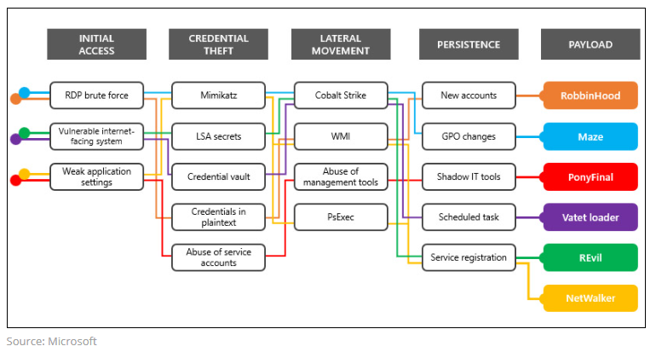
Ransomware Attack Stages
Initial Access
Credential Theft
Lateral Movement
Persistence
Payload (Encryption)

Slide 40
Areas You Should be Monitoring
Initial Access
All Remote Access (firewalls, vpn, authentication, MFA, etc.)
All Internet Facing Systems
Application Configuration Changes
Credential Theft
Login Activity, Privilege Escalation Indicators, Privileged Account Changes
Lateral Movement
SMB Traffic, Unusual traffic patterns, “first time” behavior, User Behavior
Persistence (Back Doors)
Account Behaviors/Changes, Beacon Traffic, IP Reputation, Encrypted Comms
Payload (Encryption)
Any/All Encryption Activity

Slide 41
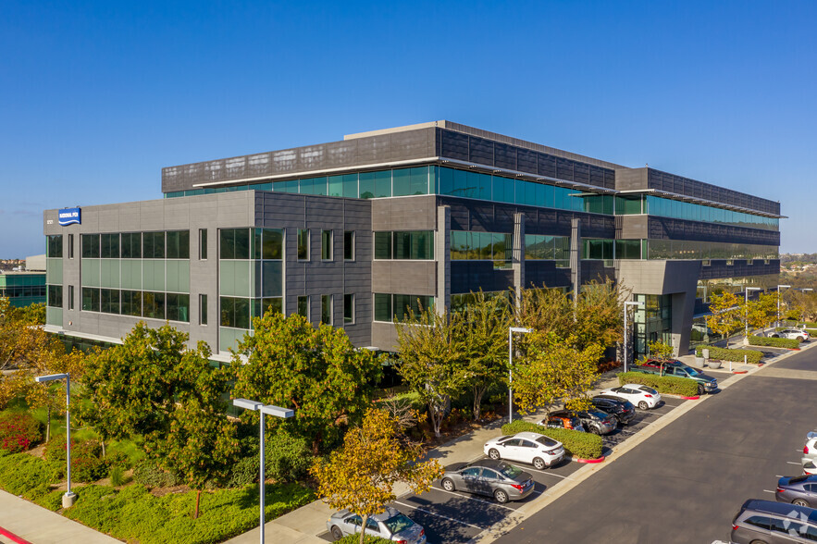
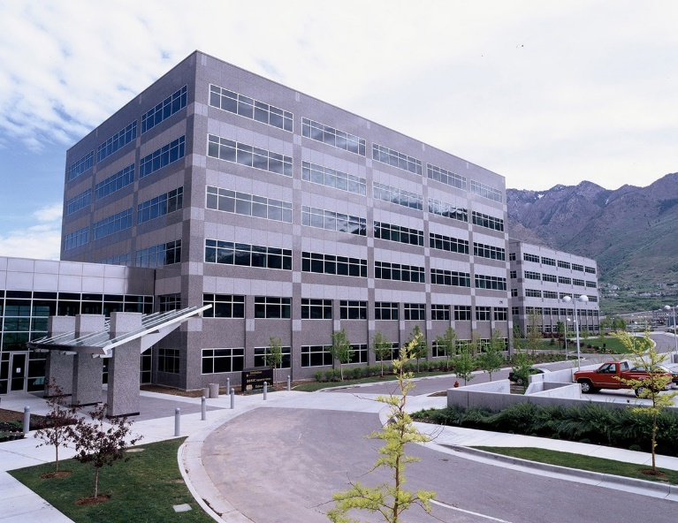
Security Operations Centers (US)
Security On-Demand
3 SOC Locations
US – 2 Locations
Europe – 1 Location
SOC Tours Welcome
New SLC SOC Opening in Q4 2021!
San Diego, CA
Security Operations Center
(24x7)
I-15 & Scripps Ranch Area
20 Minutes from SAN Airport
Salt Lake City, Utah (Q4)
Security Operations Center
(24x7)
I-215 & Cottonwood Cyn Area
20 Minutes from SLC Airport

Slide 42
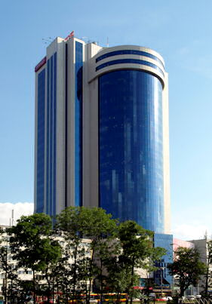
SOD Research & Development
Research & Development Team
Recently Awarded a $2.2M EU Grant
250 Papers Published, 7 Patents Held
World Leading Experts in Machine Learning & AI
Experts in the mathematics of pattern analysis
Established May 2017
20 Staff – Researchers, Scientists & Developers
9 Ph.D. – Data Scientists & Mathematicians
5 Master’s Degrees in Mathematics & Computer Science
Warsaw, Poland Research Center & SOC
Millennium Atlas Tower al. Jerozolimskie 123A, piętro 23 02-017 Warszawa Poland

Slide 43
SOD’s Differentiation - Full Spectrum, Dynamic Analysis
ADAT – Analysis of ALL the Data vs Data Reduction (not analyzing all the data)
S2-D2 – Dynamic Detection, Dynamic Remediation
Patented AQ Technology – Can find patterns in seemingly random events
Threat Ecosystem – Open Architecture, integration with 3rd Party SIEM, Intel, SOAR
Notes:
The solutions is Data Driven Intelligence
What you need to do is find patterns in seemingly Random Events.
You can not do this with Data Reduction, you must look at all the data all the time.
Today we process over 30Billion events per day. (This is not duping threat feed data, but rather live fire data. Most of this is valid traffic and the common industry method is to reduce the data sets. We have found that the bad actors all know how the data reduction works and have approaches to hide in the light of day.
This allows us ADAT, all the data all the time.
This technology is called AQ and was developed by our PHD researcher’s in our Warsaw Office. Over the last 5 years.
We are currently rolling out our third version of this technology called AQs

Slide 44
Pricing
Pricing is “Device Based” not volume based
There are no limits to the amount of volume that can be sent to SOD.
SOD has worked with state and local government agencies in other states to pool contracts for pricing discounts.
SOD has built “Consortium” Pricing Model so that State agencies, counties, cities and other government entities can share volume pricing.
Please contact Kim Scott (kscott@securityondemand.com) or your IP Pathways account manager for further information.

Slide 45
Questions
Please contact us for a copy of this presentation
www.securityondemand.com
pbybee@securityondemand.com

